Slide 1
ONLINE NIGHT 1 · 5:30 PM – 8:00 PM CST
Pregnancy Physiology
& When Pregnancy Goes Wrong
Mary's Hands Network
ICEA Certified Birth Doula
Hybrid Training

Slide 2
WELCOME · 5:30 – 5:40 PM
Welcome & Housekeeping
Tonight: pregnancy + warning signs
Two short breaks: 6:20 and 7:20
Camera on if you can. Mute when not talking.
Use chat for questions any time
Ice-breaker: one word — why are you here?
Mary's Hands Network · ICBD Hybrid Training · Night 1
Welcome & Housekeeping

Slide 3
TONIGHT'S FOCUS
Learning Objectives
Know what changes happen each trimester
Use safe ways to help with pregnancy aches
Know the main pregnancy tests
Know what a doula can and cannot do
Spot warning signs that need a doctor now
Speak up when a client's worries get brushed off
See how racism hurts Black moms in Louisiana
Mary's Hands Network · ICBD Hybrid Training · Night 1
Learning Objectives
Notes:
--- Original detail ---
Explain the physical and emotional changes that occur during each trimester of pregnancy
Offer evidence-based comfort strategies for the most common pregnancy discomforts
Describe major prenatal tests and your role in supporting clients through them
Describe the doula's role during the prenatal period, including scope of practice
Recognize the warning signs of preeclampsia and other complications requiring immediate attention
Practice advocacy language for when a client's concerns are minimized or dismissed
Describe the impact of racial health disparities on maternal outcomes in Louisiana

Slide 4
Normal Pregnancy:
Physiology & the Doula's Role

Slide 5
HOW PREGNANCY BEGINS · STEP 1
Fertilization
Sperm and egg meet in the fallopian tube
The cells start dividing right away
Baby's DNA is set right here
Pregnancy is counted from the last period
Most people are 2 weeks 'pregnant' before sex even happened
Mary's Hands Network · ICBD Hybrid Training · Night 1
Fertilization
Notes:
--- Original detail ---
Sperm meets egg in the fallopian tube, forming a fertilized egg called a zygote
The zygote immediately begins dividing as it travels toward the uterus
The genetic blueprint is fixed at this exact moment — chromosomes, biological sex, and many inherited traits are set here
Pregnancy is dated from the first day of the last menstrual period — not from conception
Most people are already 2 weeks "pregnant" before conception even occurs

Slide 6
HOW PREGNANCY BEGINS · STEP 2
Implantation
Days 6–10: the tiny ball of cells digs into the uterus lining
This sends out hCG — the hormone that turns a pregnancy test positive
Some people see light spotting and think it's a period
If it doesn't dig in, the lining sheds like a normal period
They may never know they were briefly pregnant
Mary's Hands Network · ICBD Hybrid Training · Night 1
Implantation
Notes:
--- Original detail ---
Around days 6–10 after fertilization, the blastocyst burrows into the uterine lining (the endometrium)
This triggers the release of hCG — human chorionic gonadotropin — the hormone pregnancy tests detect
Some people notice light spotting at implantation and mistake it for a period
If implantation fails, the lining sheds as a normal period — most very early pregnancies end this way
The person will never know they were briefly pregnant

Slide 7
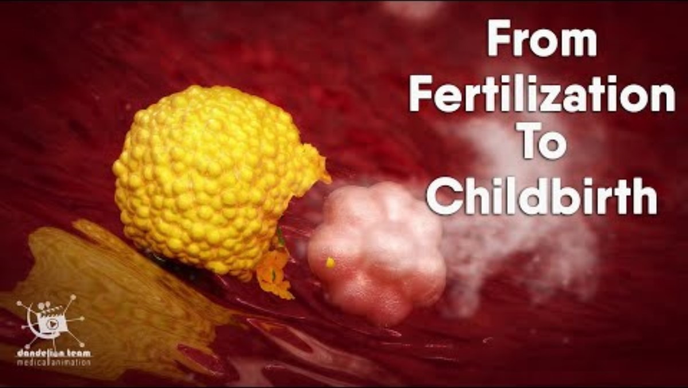

Slide 8
HOW PREGNANCY BEGINS · THE LIFE SUPPORT SYSTEM
The Placenta
The only organ the human body grows — and then discards.
Delivers Oxygen & Nutrients
Removes Fetal Waste
Produces Key Hormones
Development & Delivery
Mom and baby's blood never mix
It lets through oxygen, sugar, and vitamins
It blocks most germs and toxins
Baby's waste (like CO2) goes back through to mom's blood to leave the body.
Around week 10, the placenta takes over the pregnancy hormones.
Fully working by weeks 12–16. About 1–1.5 lbs at birth. Comes out after the baby.
Mary's Hands Network · ICBD Hybrid Training · Night 1
The Placenta
Notes:
--- Original detail ---
Maternal and fetal blood never directly mix. The placenta acts as a selective barrier — passing oxygen, glucose, and vitamins through to the fetus while blocking most pathogens and toxins.
--- Original: Carbon dioxide and metabolic waste ---
Carbon dioxide and metabolic waste products from the fetus cross back through the placenta into the mother's circulation for disposal.
--- Original: Takes over hormone production around wee ---
Takes over hormone production around week 10 — producing hCG, progesterone, and estrogen to sustain the pregnancy and drive physical changes.
--- Original: Fully functional by weeks 12–16 ---
Fully functional by weeks 12–16. Continues growing until birth, ultimately weighing about 1–1.5 lbs. Delivered as the third stage of labor.

Slide 9
THE HORMONES OF PREGNANCY · OVERVIEW
Six Hormones Drive Every Symptom Your Client Feels
Understanding these hormones lets you explain exactly why your client feels the way she does.
hCG
Progesterone
Estrogen
Makes you nauseous · shows up on tests · peaks at week 10
Keeps the pregnancy going. Causes heartburn and tiredness.
Grows things. Drives blood flow, glow, skin changes.
Relaxin
Oxytocin
Cortisol
Loosens ALL joints — back pain, hip pain, clumsy moments.
Builds slowly. Triggers labor. Drives bonding.
Goes up over time. Long-term stress = risk.
Mary's Hands Network · ICBD Hybrid Training · Night 1
Hormone Overview
Notes:
--- Original detail ---
Causes nausea, detected by pregnancy tests, peaks at week 10
--- Cortisol — The Stress Hormone ---
Rises steadily throughout pregnancy — this is normal and necessary
Adapts the immune system to tolerate the fetus, which is genetically foreign tissue
Supports fetal lung and organ development in the third trimester
Chronically elevated cortisol from unmanaged stress is linked to increased preterm labor risk and lower birth weight
Doula presence reduces cortisol — this is one mechanism behind the Cochrane Review data showing improved outcomes
--- Oxytocin — "The Love Hormone" ---
Builds gradually throughout pregnancy and peaks at the onset of labor
Triggers and sustains uterine contractions — Pitocin is synthetic oxytocin
Released in response to touch, eye contact, warm skin contact, and emotional safety
Drives maternal bonding after birth — skin-to-skin contact floods the system with oxytocin
Also responsible for the milk let-down reflex during breastfeeding
--- Relaxin — The Joint & Ligament Relaxer ---
Primary job: loosen the pelvic ligaments so the pelvis can widen enough for birth
The problem: it loosens ALL ligaments in the body, not just pelvic ones
Causes back pain, round ligament pain (sharp lower belly pains), and symphysis pubis dysfunction (SPD)
The "pregnancy clumsiness" clients describe — dropping things, misjudging distances — is relaxin destabilizing joints
Levels peak in the first trimester, stay elevated throughout, and resolve after birth or after breastfeeding ends
--- Estrogen — Growth, Blood Flow & Change ---
Drives uterine growth to accommodate the expanding baby
Stimulates breast tissue development in preparation for lactation
Increases blood flow to the skin — responsible for the "pregnancy glow"
That same blood flow also causes nasal congestion, nosebleeds, and bleeding gums
Drives skin changes: stretch marks, linea nigra (the dark midline), and melasma (facial pigmentation)
--- Progesterone — "The Pregnancy Hormone" ---
Maintains the uterine lining so the embryo stays implanted
Suppresses uterine contractions to protect the pregnancy
Relaxes smooth muscle throughout the entire body — causes heartburn, constipation, and bloating
Has a sedating effect — directly responsible for first-trimester fatigue
Rises steadily throughout pregnancy; a sudden drop after birth contributes to baby blues
--- hCG — Human Chorionic Gonadotropin ---
Produced by the placenta starting at implantation
The hormone pregnancy tests detect — levels double every 48–72 hours in early pregnancy
Surges dramatically in the first trimester, peaks around week 10, then drops off
Triggers the nausea center in the brainstem — explains why first-trimester nausea is worst at the peak
Also signals the ovaries to stop producing eggs for the duration of the pregnancy

Slide 10
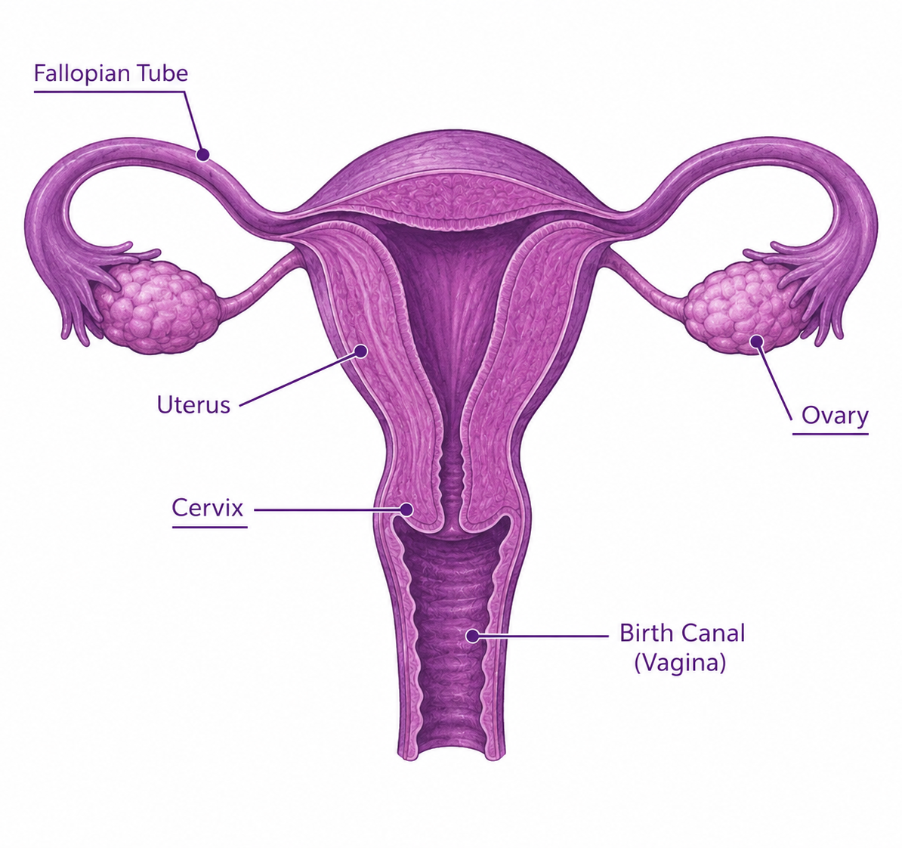
ANATOMY & PHYSIOLOGY · UPPER BODY
The Uterus — The Engine of It All
From pear-sized to watermelon-sized. Everything else moves to make room.
Starts pear-sized: 3 ounces
Grows to watermelon-sized: about 2 pounds
Pushes every organ up and to the sides
Causes most third-trimester aches
One of the strongest muscles in your body
Mary's Hands Network · ICBD Hybrid Training · Night 1
Anatomy: The Uterus
Notes:
--- Original detail ---
Starts as a pear-sized, 3-ounce organ tucked deep in the pelvis
By full term it is the size of a watermelon and weighs about 2 pounds
Pushes every organ in the abdominal cavity upward, outward, and to the sides
This single structural change causes the majority of third-trimester symptoms
The uterine muscle must contract powerfully during labor — it is one of the strongest muscles in the human body

Slide 11
ANATOMY & PHYSIOLOGY · UPPER BODY
Stomach, Intestines & Diaphragm
Stomach & Intestines
Squeezed by the growing uterus. Hormones slow digestion. Result: heartburn, gas, constipation. Worse after meals and lying down.
T2 onward, worst in T3
Diaphragm
Pushed up about 4 cm in T3. Lungs have less room. Causes shortness of breath. Gets better when baby drops in late T3.
Third trimester
Mary's Hands Network · ICBD Hybrid Training · Night 1
Anatomy: Upper Body Changes
Notes:
--- Original detail ---
Pushed upward and compressed by the growing uterus. Progesterone slows gut motility. Result: heartburn, constipation, bloating, and slower digestion. Heartburn worsens after meals and when lying flat.

Slide 12
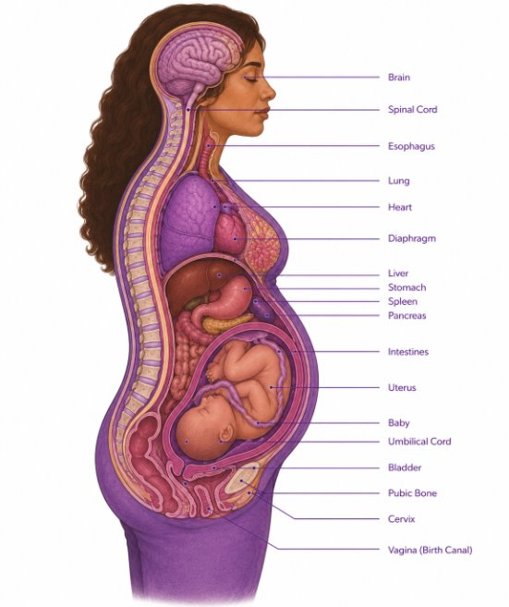
ANATOMY & PHYSIOLOGY · LOWER BODY & SYSTEMIC
Bladder, Kidneys & Cardiovascular System
Squeezed by hormones in T1, by baby's head in T3. Peeing a lot is just structural — not a bladder problem.
Bladder
T1 and T3
Filtering 60–80% more blood. A bit of sugar in urine is normal.
Kidneys
Throughout pregnancy
Blood volume goes up 40–50%. Heart beats 10–20 more times a minute. Heart works 30–50% harder.
Heart
T1 through birth
Mary's Hands Network · ICBD Hybrid Training · Night 1
Anatomy: Lower Body & Systemic

Slide 13


Slide 14
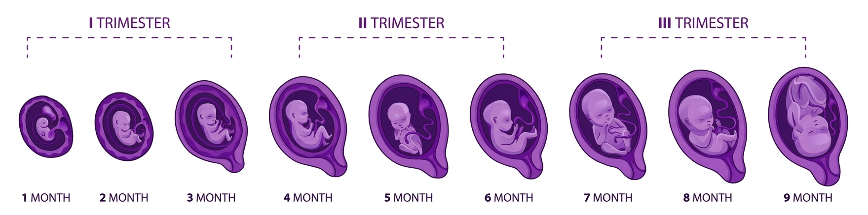
FIRST TRIMESTER
The Foundation — Critical Development
Days 1–14: Sperm + egg meet. Cells divide. Ball burrows into uterus.
Week 4: Brain and spine start forming. Tiny heart starts beating.
Weeks 5–8: All major organs start to form
Week 8: Now called a fetus. Tiny fingers and toes — about 1 inch long.
Week 10: Placenta takes over hormones
Week 13: A face you can see. About 3 inches and 1 ounce.
Mary's Hands Network · ICBD Hybrid Training · Night 1
First Trimester: Fetal Development
Notes:
--- Original detail ---
Days 1–14: Fertilization, cell division, and implantation into the uterine wall
Week 4: Neural tube forms — closes by day 28. Heart tube begins beating
Weeks 5–8: All major organ systems established — heart, brain, kidneys, liver, lungs
Week 8: Now called a fetus. Fingers and toes forming. About 1 inch long
Week 10: Placenta takes over hormone production from the corpus luteum
Week 13: Facial features recognizable, vocal cords forming — 3 inches and 1 ounce

Slide 15
FIRST TRIMESTER
Often the Hardest — With No Visible Bump
Nausea (70–80%) — not just in the morning
Super tired — your body is building a placenta
Sore breasts. Peeing all the time. Hate certain smells.
Big feelings — fear, doubt, and joy all at once
No bump yet — can feel unreal
Highest miscarriage risk now — your job is calm and care
Mary's Hands Network · ICBD Hybrid Training · Night 1
First Trimester: The Pregnant Person
Notes:
--- Original detail ---
Nausea and vomiting — affects 70–80% of pregnant people and can happen all day, not just morning
Extreme fatigue — the body is building a placenta; this is physiologically exhausting
Breast tenderness, frequent urination, food aversions, heightened sense of smell
Emotional ups and downs from hormonal surges — fear, ambivalence, and excitement can all coexist
No visible bump yet — pregnancy can feel abstract or surreal, especially for first-time parents
Miscarriage risk is highest now — your most anxiety-containing work happens in T1

Slide 16
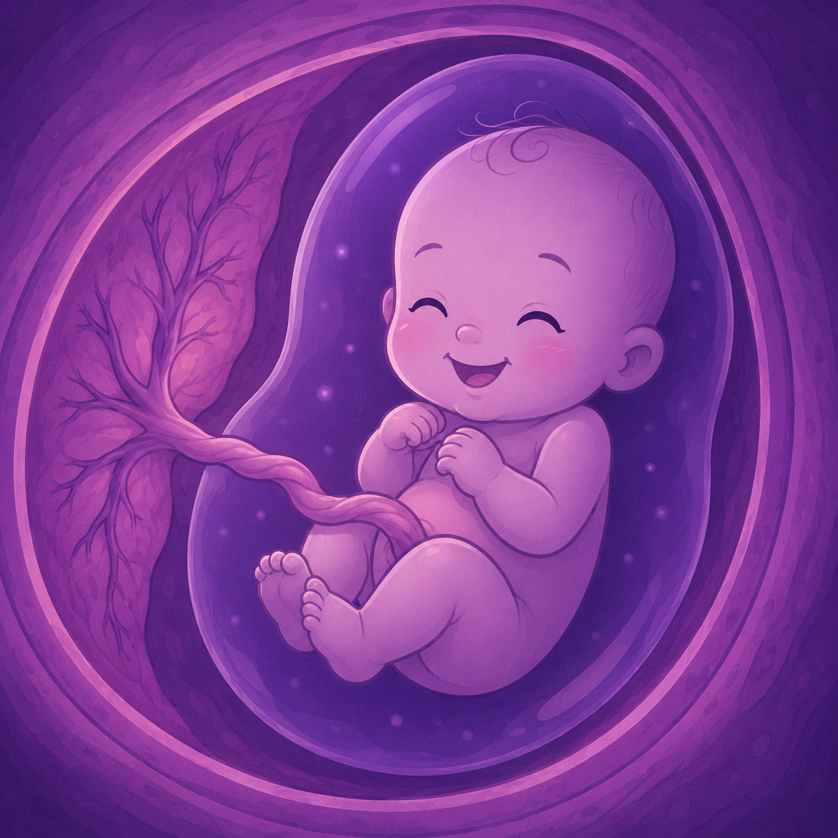
SECOND TRIMESTER
The Growth Surge — Senses & Viability
Weeks 14–16: Baby makes faces, sucks, hiccups
Week 16: Fingerprints form. Bones harden up.
Weeks 18–22: Mom feels baby move for the first time (quickening)
Mary's Hands Network · ICBD Hybrid Training · Night 1
Second Trimester: Fetal Development
Notes:
--- Original detail ---
Weeks 14–16: Making facial expressions, sucking movements, hiccupping
Week 16: Fingerprints form; skeleton hardening from cartilage to bone
Week 18–22: Quickening — the pregnant person begins feeling fetal movement for the first time

Slide 17
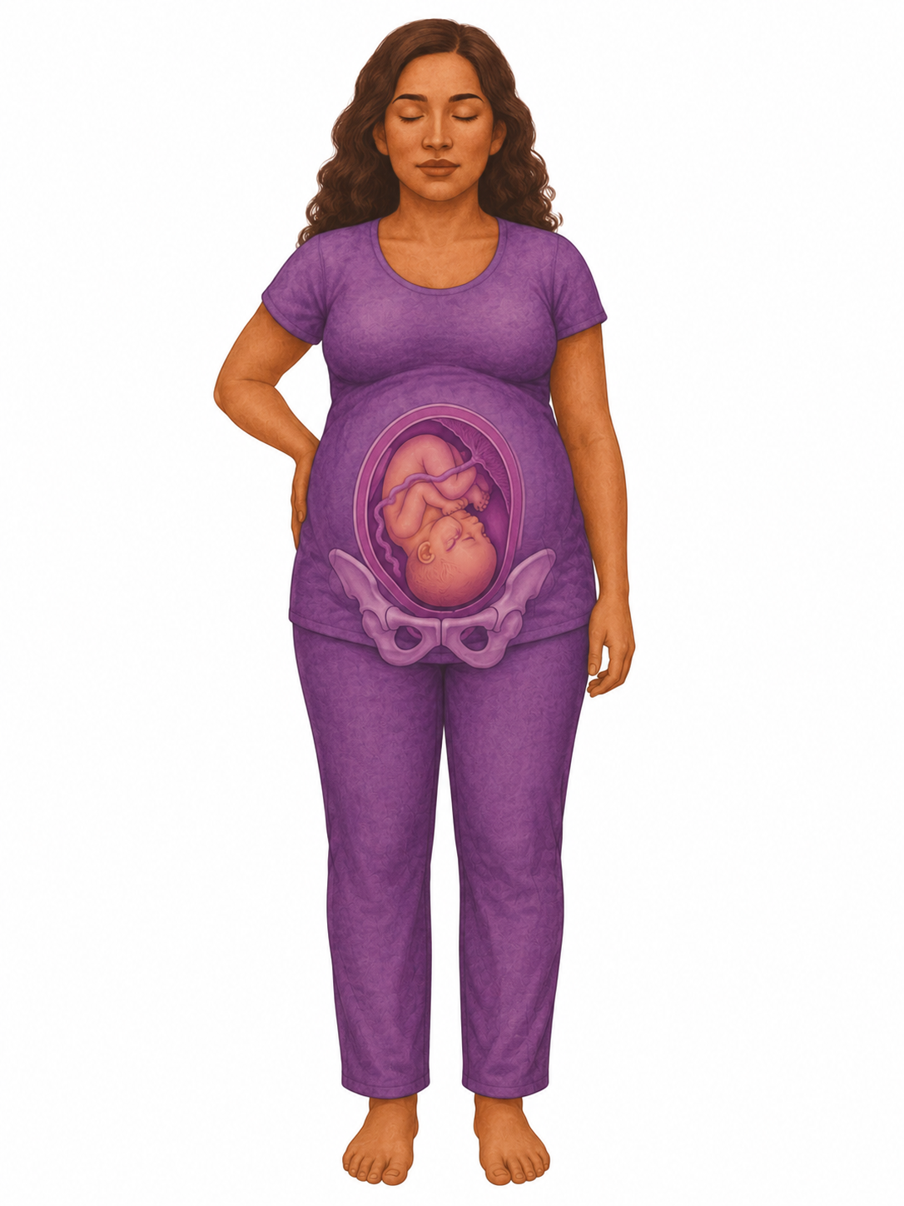
SECOND TRIMESTER
The Growth Surge — Senses & Viability
Week 20: Baby swallows fluid. Tastes. Hears sounds outside.
Week 24: Could survive with NICU care if born now
Week 27: Eyes open. About 14 inches, 2 pounds.
Mary's Hands Network · ICBD Hybrid Training · Night 1
Second Trimester: Fetal Development
Notes:
--- Original detail ---
Week 20: Baby can swallow amniotic fluid, taste, and hear sounds from outside the womb
Week 24: Threshold of viability — with intensive NICU care, survival is possible
Week 27: Eyes beginning to open — about 14 inches and 2 pounds

Slide 18
SECOND TRIMESTER
The Honeymoon Period — Energy Returns
Nausea fades. Energy comes back.
Bump shows — feels real for the first time
Sharp belly pains as the uterus stretches
Stuffy nose, nosebleeds, bleeding gums
Skin changes: glow, stretch marks, dark line on belly
Best time to plan the birth and build trust
Mary's Hands Network · ICBD Hybrid Training · Night 1
Second Trimester: The Pregnant Person
Notes:
--- Original detail ---
Nausea often subsides and energy returns — many people feel more like themselves
Baby bump becomes visible — can feel affirming and real for the first time
Round ligament pain begins — sharp lower abdominal pains as the uterus expands
Nasal congestion, nosebleeds, and bleeding gums from increased blood volume
Skin changes: the pregnancy glow, stretch marks, linea nigra, melasma
Begin discussing birth preferences and fears — this is prime prenatal relationship-building time

Slide 19
THIRD TRIMESTER
The Final Preparations — Fat, Lungs & Position
Weeks 28–32: Quick weight gain. Baby fat builds up.
Weeks 32–36: Lungs make surfactant — needed to breathe
Week 37: 'Early term' — lungs ready but brain still growing
Weeks 39–40: Best time to be born. Baby moves head-down.
Full term: 19–21 inches, 6–9 lbs
Mary's Hands Network · ICBD Hybrid Training · Night 1
Third Trimester: Fetal Development
Notes:
--- Original detail ---
Weeks 28–32: Rapid weight gain, body fat accumulating for temperature regulation after birth
Weeks 32–36: Lungs produce surfactant — the substance that keeps air sacs open after birth
Week 37: "Early term" — lungs functional but brain still developing rapidly through week 39
Weeks 39–40: Developmentally optimal; baby settles head-down as space shrinks
Full term: 19–21 inches, 6–9 lbs, all systems ready

Slide 20
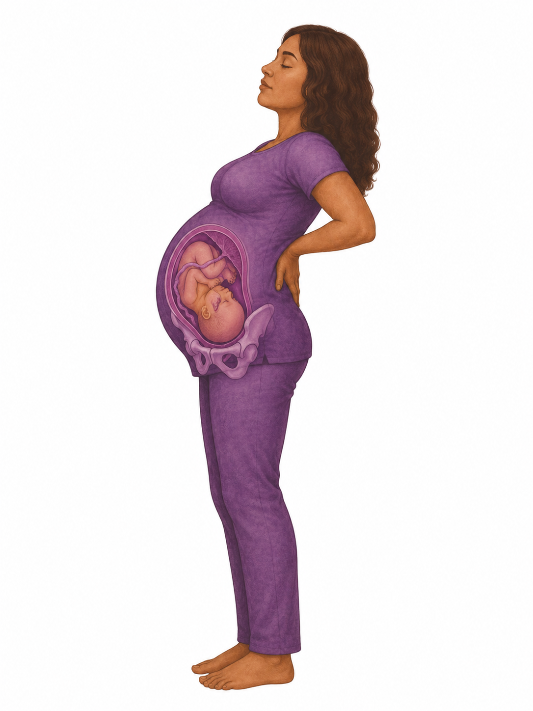
THIRD TRIMESTER · Weeks 28–40+ · FOR THE PREGNANT PERSON
The Home Stretch — Intensity & Anticipation
Tired, heavy, hard to sleep, short of breath
Heartburn gets worse
Pressure down low. Sharp 'lightning' pains. Peeing again.
Swelling in feet and hands — sudden bad swelling = red flag
Nesting — sudden urge to clean and organize
Big feelings: excited, scared, impatient
Mary's Hands Network · ICBD Hybrid Training · Night 1
Third Trimester: The Pregnant Person
Notes:
--- Original detail ---
Increasing discomfort — carrying extra weight, difficulty sleeping, shortness of breath
Heartburn and indigestion intensify as the uterus presses on the stomach
Pelvic pressure, lightning crotch (sharp pelvic pains), and frequent urination return
Swelling in feet, ankles, and hands — normal if gradual; sudden severe swelling is a red flag
Nesting instinct — a sudden urge to clean, organize, and prepare
Emotional intensity — anticipation, fear, excitement, and impatience all at once

Slide 21
EMOTIONAL & PSYCHOLOGICAL CHANGES
How Mom Feels Inside
Mixed feelings are normal — fear + joy + doubt all at once
Body image shifts. Identity shifts.
Partner dynamics change
Your job: listen and validate — don't fix
Big feelings DON'T mean regret
Mary's Hands Network · ICBD Hybrid Training · Night 1
How Mom Feels Inside

Slide 22
COMMON PREGNANCY DISCOMFORTS
Nausea & Vomiting
Affects 70–80% of pregnant people. Can happen any time of day.
What you can offer:
When to refer to provider:
Small, frequent meals — empty stomach makes it worse
Ginger: tea, candies, fresh ginger
Vitamin B6 (ask the doctor first)
Sea-Band wristbands (acupressure)
Skip your trigger smells and foods
Inability to keep fluids down for 24 hours, weight loss, or vomiting more than 3–4 times per day may indicate hyperemesis gravidarum — refer to provider.
Doula script:
"Morning sickness is miserable and I'm sorry you're dealing with it. Try eating small amounts frequently — even crackers or toast. Protein helps. And ginger really works for some people."
Mary's Hands Network · ICBD Hybrid Training · Night 1
Discomfort: Nausea & Vomiting
Notes:
--- Original detail ---
Small, frequent meals — an empty stomach worsens nausea
Ginger: tea, candies, or fresh ginger — evidence supports its effectiveness
Vitamin B6 with provider approval
Acupressure wristbands (Sea-Bands)
Avoid known triggers — certain smells, foods, or activities

Slide 23
COMMON PREGNANCY DISCOMFORTS
Heartburn & Indigestion
Up to 80% of pregnant people experience this — especially in the third trimester.
What you can offer:
When to refer to provider:
Small meals, not big ones
Skip spicy, fatty, fried, acidic food
Don't lie down for 2–3 hours after eating
Sleep with your head propped up
Chew gum — spit lowers acid
If severe or not responding to dietary changes, the provider can recommend safe antacids for use during pregnancy.
Doula script:
"Heartburn is so common in pregnancy because hormones relax the valve at the top of your stomach and the baby is pushing everything upward. Small meals and sleeping propped up really help."
Mary's Hands Network · ICBD Hybrid Training · Night 1
Discomfort: Heartburn & Indigestion
Notes:
--- Original detail ---
Small, frequent meals instead of large ones
Avoid spicy, acidic, fatty, or fried foods
Don't lie down for 2–3 hours after eating
Sleep with the head elevated — gravity keeps acid down
Chew gum: increases saliva, which neutralizes acid

Slide 24
COMMON PREGNANCY DISCOMFORTS
Swelling (Edema)
Normal in the feet, ankles, and hands — especially in the third trimester. Blood volume has increased 40–50%.
What you can offer:
When to refer to provider:
Put your feet up when sitting
Don't stand for long stretches
Drink water — it actually helps
Cut back on salt
Try compression socks if it's bad
Sudden, severe swelling in the face, hands, or around the eyes — especially with headache or vision changes — requires immediate evaluation. One leg significantly more swollen than the other may indicate a blood clot.
Doula script:
"Swelling in your feet and ankles is really common, especially in the heat or at the end of the day. Elevating your feet helps. Drinking water actually helps reduce it, even though that seems backward."
Mary's Hands Network · ICBD Hybrid Training · Night 1
Discomfort: Swelling (Edema)
Notes:
--- Original detail ---
Elevate feet when sitting or resting
Avoid standing for long periods
Stay hydrated — counterintuitively, this reduces swelling
Reduce sodium intake
Compression stockings if swelling is significant

Slide 25
COMMON PREGNANCY DISCOMFORTS
Back & Pelvic Pain
Caused by shifted center of gravity, relaxin loosening ligaments, and a growing uterus.
What you can offer:
When to refer to provider:
Stand tall — shoulders back, pelvis tucked
Wear good shoes — no heels
Try prenatal yoga or gentle stretches
Use heat on your back (not on the belly)
Sleep on your side with a pillow between knees
Severe, persistent pain or symphysis pubis dysfunction (SPD) may benefit from a referral to a prenatal physical therapist.
Doula script:
"Your body is doing a lot of shifting and adjusting. Back pain is really common. Stretching helps, heat helps, and changing positions often helps. If it gets bad, prenatal PTs do amazing work."
Mary's Hands Network · ICBD Hybrid Training · Night 1
Discomfort: Back & Pelvic Pain
Notes:
--- Original detail ---
Good posture coaching — shoulders back, pelvis tucked
Supportive shoes — avoid heels
Prenatal yoga or gentle stretching
Heat for muscle pain (not directly on belly)
Side-lying with a pillow between the knees for sleep

Slide 26
COMMON PREGNANCY DISCOMFORTS
Fatigue
Real, intense, and often underestimated — especially in T1 and again in T3.
What you can offer:
When to refer to provider:
Tell her: resting is not lazy. It's the work.
Short naps (20–30 minutes)
Protein + complex carbs for steady energy
Drink water — being dry makes you more tired
Light walks can actually wake you up
Extreme, debilitating fatigue beyond what is typical may indicate anemia — encourage provider to check iron levels.
Doula script:
"Your body is working so hard right now — harder than it would running a marathon. Of course you're tired. Rest when you can. This isn't laziness. This is your body doing exactly what it needs to do."
Mary's Hands Network · ICBD Hybrid Training · Night 1
Discomfort: Fatigue
Notes:
--- Original detail ---
Give explicit permission to rest — this is essential, not lazy
Short naps (20–30 minutes) if possible
Protein and complex carbs for steady energy
Hydration — dehydration worsens fatigue
Gentle movement, like walking, can actually increase energy

Slide 27
COMMON PREGNANCY DISCOMFORTS
Braxton Hicks Contractions
Practice contractions — irregular, usually painless, and stop with position change or hydration.
What you can offer:
When to refer to provider:
Drink water first — being dry sets them off
Change positions — usually stops them
Rest if they keep coming
Tell her: 'It's practice, not real labor'
If contractions become regular (every 5–10 minutes), are accompanied by pain, bleeding, or pelvic pressure before 37 weeks — call the provider. When in doubt, get it checked out.
Doula script:
"Those are Braxton Hicks contractions — your uterus is practicing for labor. They're normal and actually helpful. But if they become regular or painful before 37 weeks, always check in. When in doubt, get it checked out."
Mary's Hands Network · ICBD Hybrid Training · Night 1
Discomfort: Braxton Hicks Contractions
Notes:
--- Original detail ---
Hydration — dehydration is a common trigger
Position change — often stops them immediately
Rest if they are frequent
Reassurance that this is the uterus practicing for labor, not early labor

Slide 28
PRENATAL CARE · NAVIGATION & INFORMED DECISION-MAKING
Prenatal Testing — What Your Clients Go Through
Test
Timing
What It Screens
Your Role
First Trimester Screening
10–13 wks
Checks for genetic conditions. Blood test + ultrasound. Gives a risk number, NOT a yes/no.
Help her know: high risk does not mean a sick baby. Lots of healthy babies after high-risk results.
Anatomy Scan
18–22 wks
Detailed look at baby's body, placenta, and fluid. Can find out sex.
Normal to feel both excited and scared. Help her write down questions first.
Glucose Screening
24–28 wks
Checks for pregnancy diabetes. A high 1-hour test doesn't always mean you have it.
Tell her to bring a snack. Normalize the test.
Group B Strep
36–37 wks
Normal bacteria in 25–30% of people. If positive: antibiotics during labor.
Normal — not an infection. Not her fault.
Mary's Hands Network · ICBD Hybrid Training · Night 1
Prenatal Testing Overview

Slide 29
PRENATAL CARE · CLINICAL NOTE
Prenatal Vitamins — Why They Matter
Folic acid stops brain and spine birth defects. Those happen in the first 28 days — before most people know they're pregnant. Cuts the risk by 50–70%. Iron is just as important — your blood volume goes up 40–50%, and many people are low.
When clients can't or won't take them:
'They make me nauseous.' → Try them at night, with food, or as gummies (note: gummies often skip iron). 'I can't afford them.' → WIC gives them free. Clinics often have samples. 'I keep forgetting.' → Set a daily alarm. Put them next to something you use every day.
Mary's Hands Network · ICBD Hybrid Training · Night 1
Prenatal Vitamins

Slide 30
BREAK
6:20 PM — 6:30 PM · 10 minutes
Step away. Stretch. Hydrate. Reset.
Back at 6:30 — Doula scope and prenatal care.

Slide 31
PRENATAL CARE · CLINICAL NOTE
"Pregnancy Brain" Is Real — And Adaptive
A 2016 brain study showed pregnancy actually rewires the brain. The parts that help you read people, feel empathy, and bond with your baby get stronger. These changes last at least 2 years after birth. Short-term memory takes a hit. That's normal — not a problem.
Doula Script
'Your brain is rewiring right now to help you bond with and care for your baby. Studies show these changes are getting you ready for parenthood. You might forget where you put your phone — but your brain is getting really good at reading your baby. It's a trade-off. And it's temporary.'
Mary's Hands Network · ICBD Hybrid Training · Night 1
Pregnancy Brain

Slide 32
THE DOULA'S ROLE IN THE PRENATAL PERIOD
Scope of Practice — Knowing the Line
Within Your Scope
Outside Your Scope
Share good info about normal pregnancy
Help her come up with good questions for the doctor
Know when symptoms need a doctor
Help with normal pregnancy aches
Make normal tests feel normal
Support partners as their role grows
Diagnose anything
Tell her what meds to take
Read or explain lab results
Tell her to skip going to the doctor
Tell her yes or no on a procedure
Argue with the doctor
Mary's Hands Network · ICBD Hybrid Training · Night 1
Scope of Practice

Slide 33
BREAKOUT DISCUSSION · 10 MINUTES
Imagine a client at 36 weeks who has been Googling everything.
Based on what you just learned, what kinds of questions do you think she might bring to a prenatal visit? Pick 2–3 your group comes up with and work through how you would respond — and where scope of practice starts to matter.
Each group shares with the full class:
What is the question?
What would you say?
What would you NOT say — and why?
Mary's Hands Network · ICBD Hybrid Training · Night 1
Breakout Discussion

Slide 34
BREAK
7:20 PM — 7:30 PM · 10 minutes
Step away. Stretch. Hydrate. Reset.
Back at 7:30 — When Pregnancy Goes Wrong.

Slide 35
When Pregnancy Goes Wrong:
Danger Signs & Complications
Your job is not to diagnose. Your job is to recognize, advocate, and act.

Slide 36
BEFORE WE BEGIN PART TWO
Scope of Practice Still Applies Here
Important — Scope Reminder
You are not a medical provider. You do not diagnose. You do not prescribe. You do not override medical advice.
But you ARE an educated support person who knows when something is not right.
Sometimes that means calmly and clearly saying:
"We need to call your provider right now."
That is not overstepping. That is exactly what doulas do.
Mary's Hands Network · ICBD Hybrid Training · Night 1
Scope Reminder

Slide 37
PREECLAMPSIA · A LIFE-THREATENING COMPLICATION
What It Is
High blood pressure (≥140/90) developing after 20 weeks of pregnancy, with signs of organ stress — protein in urine, liver dysfunction, kidney problems, or low platelets.
Preeclampsia
Clinical Note
5–8%
of all
pregnancies
Severe signs: BP 160/110 or higher → stroke risk goes way up
The only cure is having the baby — everything else just buys time
HELLP syndrome — a worse version, hits 10–20% of severe cases
Can show up AFTER birth — up to 6 weeks postpartum
Mary's Hands Network · ICBD Hybrid Training · Night 1
Preeclampsia: What It Is
Notes:
--- Original detail ---
Severe features begin at BP ≥160/110 — stroke risk rises dramatically at this threshold
The ONLY cure is delivery — all other treatments buy time
HELLP syndrome is a severe variant — affects 10–20% of severe preeclampsia cases
Preeclampsia can develop AFTER birth — up to 6 weeks postpartum

Slide 38
WARNING SIGNS · MEMORIZE THESE COLD
Every doula must know these.
01
02
03
Severe
Persistent Headache
Vision Changes
Upper Abdominal Pain
Not responding to Tylenol
Blurred, spots, flashing lights
Especially on the right side
04
05
06
Sudden Severe Swelling
New Nausea or Vomiting
Decreased Fetal Movement
Face, hands, around the eyes
Onset in the third trimester
Always take seriously

Slide 39
PREECLAMPSIA · TREATMENT & POSTPARTUM RISK
What Happens After Diagnosis
Treatment
Postpartum Risk
Only cure: deliver the baby
Magnesium sulfate stops seizures
Meds bring down blood pressure
Close watch — BP, blood tests, baby checks
About 1 in 4 eclamptic seizures occur postpartum — most in the first 48 hours after birth
But postpartum preeclampsia can occur up to 6 weeks after delivery
Many cases occur in women who did NOT have preeclampsia during pregnancy
This is why your postpartum check-in visits are not optional — you may catch something no one else does
Mary's Hands Network · ICBD Hybrid Training · Night 1
Preeclampsia: Treatment & Risk
Notes:
--- Original detail ---
The ONLY cure is delivery — all treatment buys time until delivery is safe
Magnesium sulfate prevents seizures — causes intense heat, weakness, and foggy feeling
Antihypertensive medications prevent stroke by lowering dangerously high BP
Close monitoring: BP checks, blood work, non-stress tests, biophysical profiles

Slide 40
WHAT TO SAY WHEN CONCERNS ARE DISMISSED
Doula Scripts — Advocacy in Practice
When a provider minimizes symptoms:
'I hear you that this might be normal. But she's really worried, and these match classic warning signs. Can we check her BP and urine — just for peace of mind?'
When the headache has lasted all day:
'She's saying this is the worst headache of her life and Tylenol isn't touching it. Given her history, can we get her seen today?'
When your client hesitates to call:
'I know you don't want to bug them. But this is exactly what they're there for. Let's call — better to find out it's nothing. I'll call with you.'
Mary's Hands Network · ICBD Hybrid Training · Night 1
Advocacy Scripts

Slide 41
HEALTH EQUITY & MATERNAL MORTALITY IN LOUISIANA
The disparity is not a coincidence — it is a system.
2–3×
60%
2×
more likely to die
more likely to develop preeclampsia
Louisiana's maternal mortality rate
Black women face 2–3x higher pregnancy-related mortality than white women nationally
Higher rates and worse outcomes when they do
Nearly double the national average — gap is most severe for Black mothers
Clinical Note
This disparity holds across income and education levels — structural racism, not individual risk, is the primary driver. Symptoms are more often minimized in Black patients. Your informed, persistent advocacy is not optional — it is a clinical intervention.
Mary's Hands Network · ICBD Hybrid Training · Night 1
Health Equity

Slide 42
FULL GROUP DISCUSSION · 10 MINUTES
Where have you seen, read about, or heard stories of racism in healthcare?
In the news. In your own family. In your community. In your own experience as a patient.
How does knowing this change what you think a doula's role should look like?
There are no wrong answers. No requirement to have a birth work story to contribute.
Your instructor will hold space for whatever comes up.
What surprised you most about the statistics?
What would it look like for a doula to address this in practice?
What feels uncertain or hard about this conversation for you?
Mary's Hands Network · ICBD Hybrid Training · Night 1
Group Discussion — Health Equity

Slide 43
COMPLICATIONS DOULAS ENCOUNTER — BEYOND PREECLAMPSIA
An Orientation to Other Common Complications
Gestational Diabetes
Preterm Labor
6–9% of pregnancies. Managed with diet, exercise, sometimes insulin. Bigger babies. More C-sections.
Contractions before 37 weeks. Signs: regular contractions, pelvic pressure, low backache, watery discharge.
Make her diagnosis feel normal. Support diet changes without judgment.
Get her seen NOW. Don't wait and see.
Placenta Previa & Abruption
Hyperemesis Gravidarum
Previa: placenta covers the cervix — no vaginal birth. Abruption: placenta tears away — life-threatening.
Severe nausea + vomiting. Not 'just' morning sickness. May need IV fluids and hospital care.
Painless bleeding in T3 = ER, NOW.
Take her seriously. It often gets brushed off. Your presence matters.
Mary's Hands Network · ICBD Hybrid Training · Night 1
Other Complications

Slide 44
CASE STUDY · BREAKOUT DISCUSSION · 10 MINUTES
What Would You Do?
The Scenario
Your client is 34 weeks pregnant. She texts you at 9:00 PM: "I have a terrible headache and my face looks puffy. It came on fast. Should I be worried?" Her sister had preeclampsia last year.
In your group, discuss:
What do you text back — word for word?
What would change if she said the headache started yesterday?
She already called her provider and was told to "just rest and drink water" — what now?
WHAT IF she also mentions seeing spots? → 911 or immediate drive to L&D. Do not wait.

Slide 45
KEY TAKEAWAYS · NIGHT 1
What to carry with you from tonight
01
Pregnancy is a 40-week journey. Understand it well enough to support it well.
02
Trust is built BEFORE labor. That makes labor easier.
03
Pregnancy aches are REAL. Normalize them. Use what works.
04
Memorize the warning signs. Preeclampsia can hit AFTER birth too.
05
Racism is killing Black moms. Your advocacy is part of the fix.
06
Your job: watch, teach, advocate, support. Never diagnose. Never give medical advice.
Mary's Hands Network · ICBD Hybrid Training · Night 1
Key Takeaways

